Slide 1

AI Fitness Assistant
UNIVERSITY INSTITUTE OF TECHNOLOGY,
RAJIV GANDHI PROUDYOGIKI VISHWAVIDHYALAYA
BHOPAL (M.P)
A Presentation on
A REAL Time assistant to assist with exercise
Guided by:-
Mr. Atul Pandey
Assistant Professor
Dept. of Computer Applications
Presented by:-
Gagan Boniya
0101CA201014
MCA 404
MCA IV Sem

Slide 2
Presentation Flow
Abstract
Introduction
System Requirement
Python Library
Working Flow
Flowchart
Coding
Features
Screenshots
Limitation
Conclusion
Future Work
Bibliography

Slide 3
Abstract
Staying at home for long periods of time can become boring, especially when most fun activities are done outdoors.
Still, this is not an excuse to be unproductive and the extra available time is an excellent opportunity to work on your own health.
Typical gyms come with a variety of equipment and trainers who can tell you what to do. The lack of these in one's home can often be the culprit that stops them from working out. Wouldn't it be great if there existed a personal trainer that could generate workouts for you at home?
What if it could also count the repetitions of each exercise so that you can put all your concentration and energy to do one more push up?

Slide 4
Introduction
AI fitness Assistant, an application that detects the users exercise pose counts the specified exercise repetitions and provides personalized, detailed analysis about improving the users body posture.
This is an AI-based Workout Assistant to guide people who dont have access to the gym but are still willing to work out at home to maintain their physique and fitness and keep their body in good shape. To help them perform the exercises correctly and prevent them from chronicle and immediate injuries.

Slide 5
AI Concept
Artificial intelligence (AI) refers to the simulation of human intelligence in machines that are programmed to think like humans and mimic their actions. The term may also be applied to any machine that exhibits traits associated with a human mind such as learning and problem-solving

Slide 6
System Requirement
Software Used:
.Python IDLE 3.9
.PyCharm editor
.Notepad ++. 8.2
.DroidCam
.Adobe Photoshop 7.0
Operating System:- Windows 10 pro Edition (64bit)
HARDWARE USED:
.CPU configuration- AMD processor Ryzen 3
Graphics Unit – Nvidia 730
.RAM - 8 GB DDR4
.Monitor LG 19 ips monitor.

Slide 7
Programming Language
Python is a general purpose and high level programming language.
we can use Python for developing desktop GUI applications.
AI projects differ from traditional software projects. The differences lie in the technology stack, the skills required for an AI-based project, and the necessity of deep research. To implement your AI aspirations, you should use a programming language that is stable, flexible, and has tools available. Python offers all of this, which is why we see lots of Python AI projects today.

Slide 8
Programming Language & Libraries
Python: Python is a high-level, general-purpose programming language.
OpenCV :(Open Source Computer Vision Library) is an open source computer vision and machine learning software library.
NumPy: offers comprehensive mathematical functions, random number generators, linear algebra routines, Fourier transforms, and more.

Slide 9
Programming Language & Libraries
MediaPipe
Mediapipe is a cross-platform library developed by Google that provides amazing ready-to-use ML solutions for computer vision tasks.
Tkinter
Tkinter is the standard GUI library for Python. Python when combined with Tkinter provides a fast and easy way to create GUI applications. Tkinter provides a powerful object-oriented interface to the Tk GUI toolkit.

Slide 10
Programming Language & Libraries
Math-This module provides access to the mathematical functions defined by the C standard. These functions cannot be used with complex numbers.
Time- Python's time module provides a function for getting local time from the number of seconds elapsed since the epoch called localtime() .
Pillow- Formaly known as PIL,The Python Imaging Library adds image processing capabilities to your Python interpreter.

Slide 11
Programming Language & Libraries
OS- The OS module in Python provides functions for interacting with the operating system. OS comes under Python’s standard utility modules.
Threading- Python threading allows you to have different parts of your program run concurrently and can simplify your design.

Slide 12

MediaPipe

Slide 13
Working Flow
Takes input from web camera
Compare values with dataset
Provide live Stats
Task 1
Task 2
Task 3

Slide 14
Flowchart for finding Motion Detection
Start
Capturing Video
Take two squence of frame
Different?
(Compare)
No
Yes
Save two frames

Slide 15
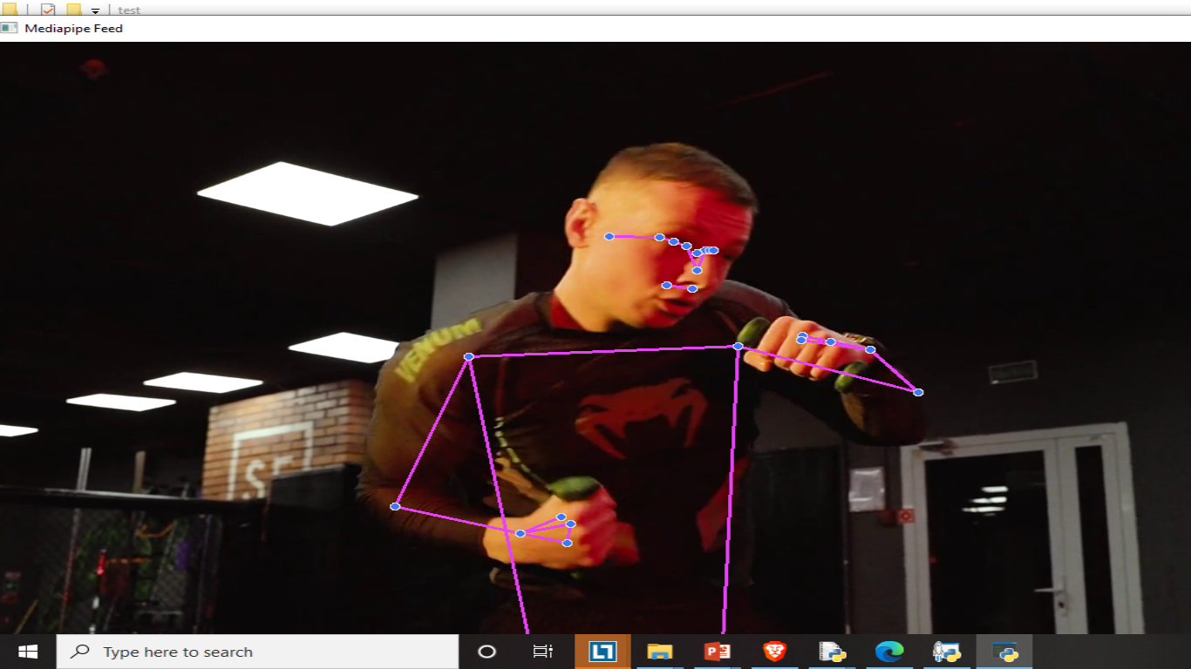
Coding for draw landmark
def findPose(self, img, draw=True):
imgRGB = cv2.cvtColor(img, cv2.COLOR_BGR2RGB)
self.results = self.pose.process(imgRGB)
if self.results.pose_landmarks:
if draw:
self.mpDraw.draw_landmarks(img, self.results.pose_landmarks,
self.mpPose.POSE_CONNECTIONS)
return img

Slide 16
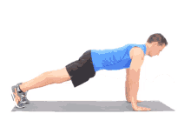
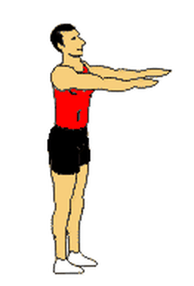
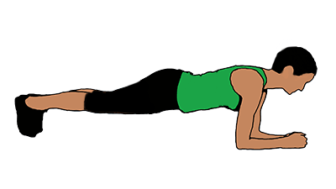
Features
Push-up:- Pushups are a fast and effective exercise for building strength. They can be done from virtually anywhere and don’t require any equipment.
Squat:- Squatting is a popular exercise that targets the muscles in the legs, lower back, and core. It can help people strengthen their muscles and burn fat. However, performing a squat without learning the proper form can cause injury.
Plank:- A plank exercise is the best exercise to strengthen your core and abdomen. These exercises strengthen your hips, lower back and abdomen and improve your body balance.

Slide 17
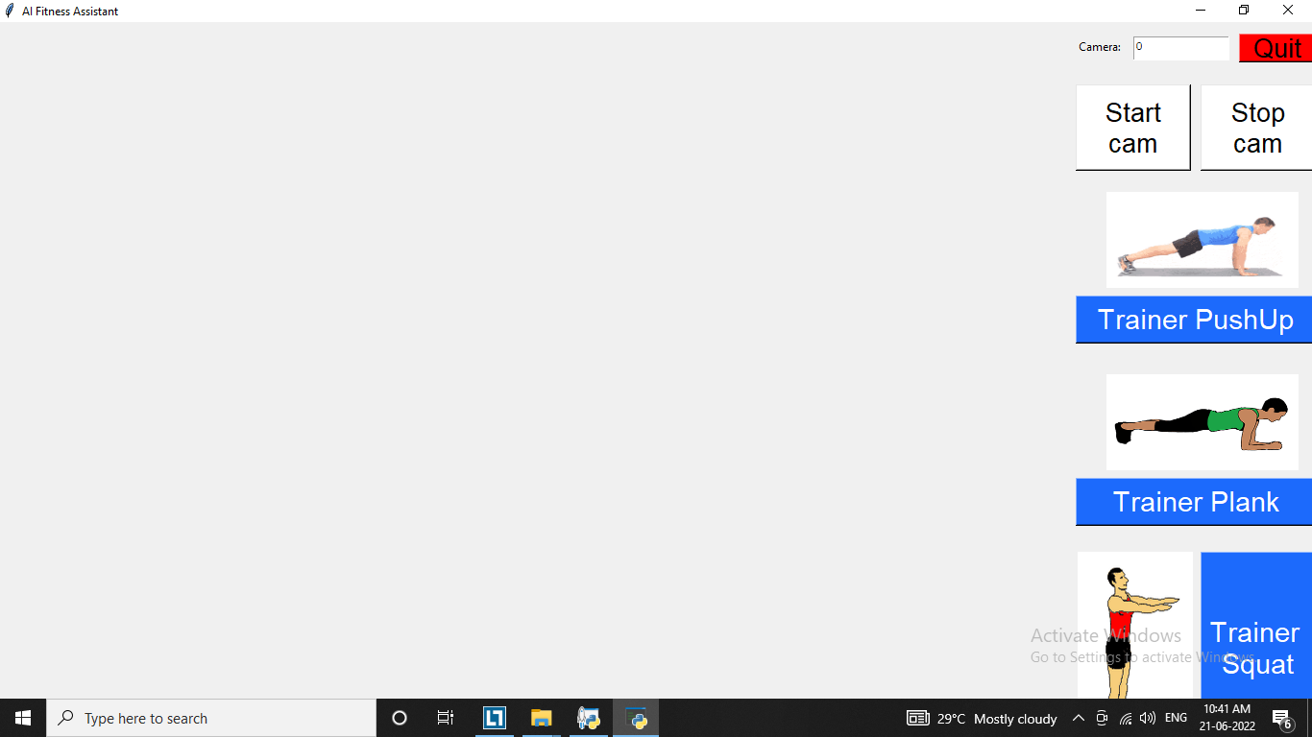
Main GUI
Camera Device
Exit Btn
Start Camera
Stop Camera
Display Area
PushUp Btn
Plank Btn
Squat Btn

Slide 18
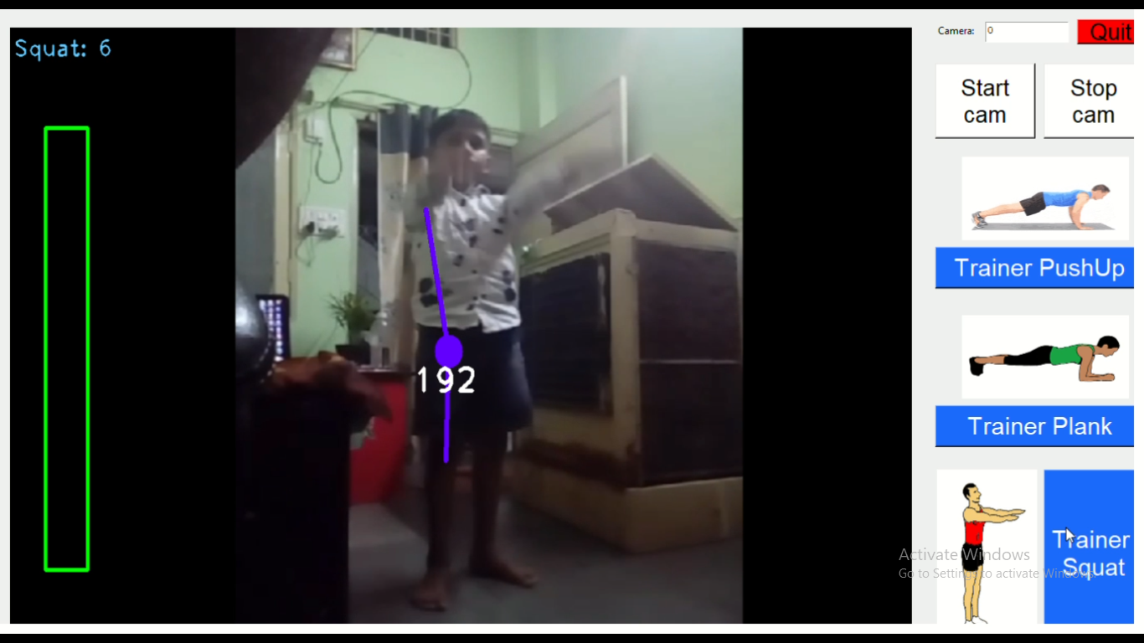
Main GUI

Slide 19
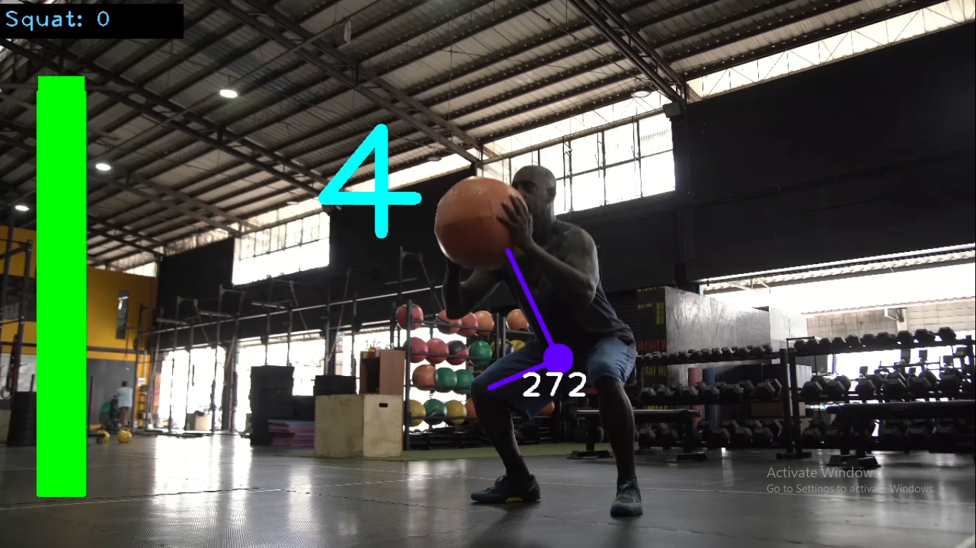
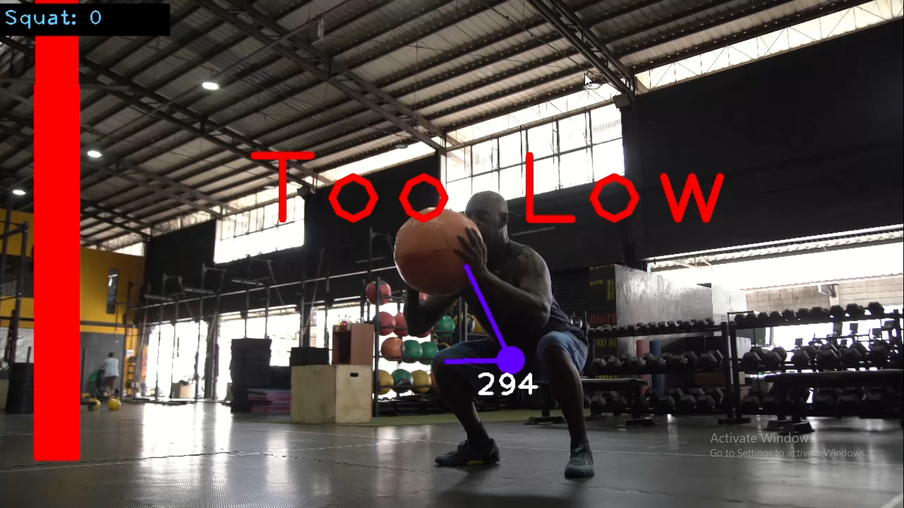
Screenshots

Slide 20
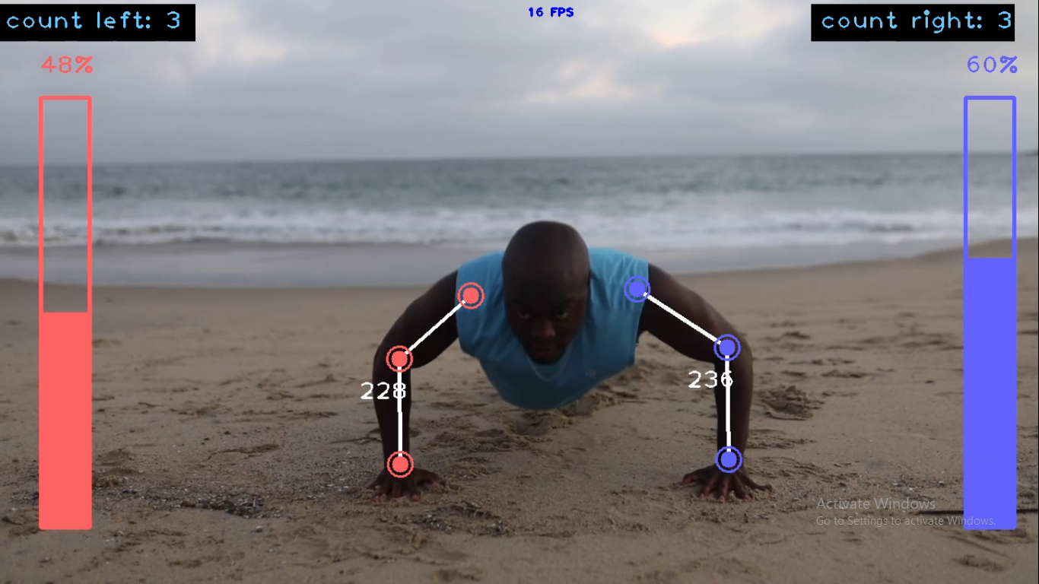
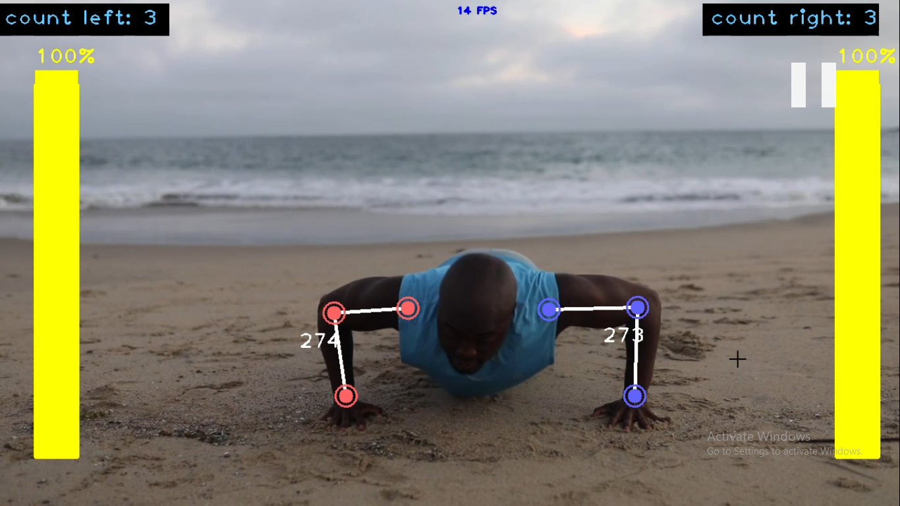
Screenshots

Slide 21
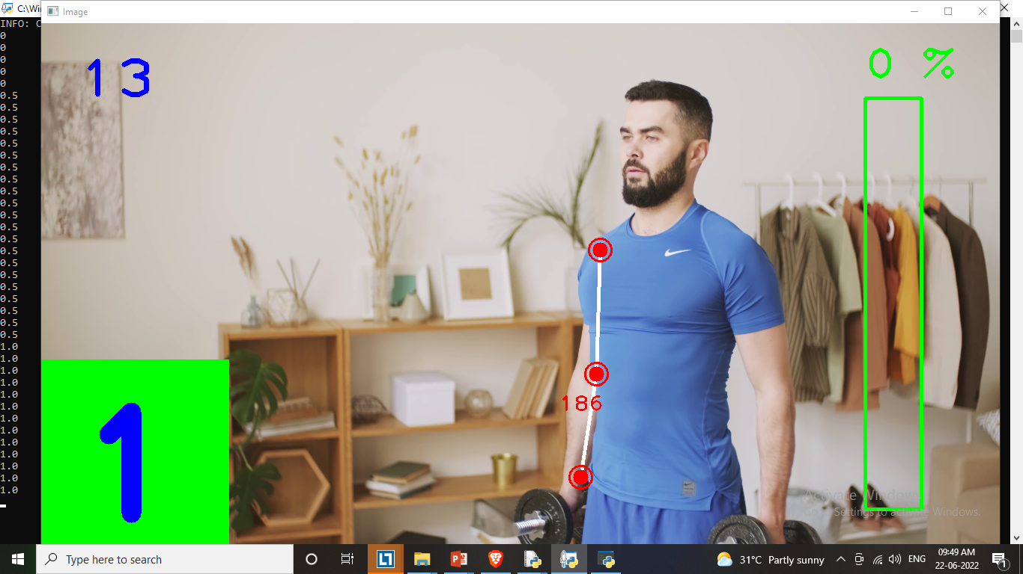
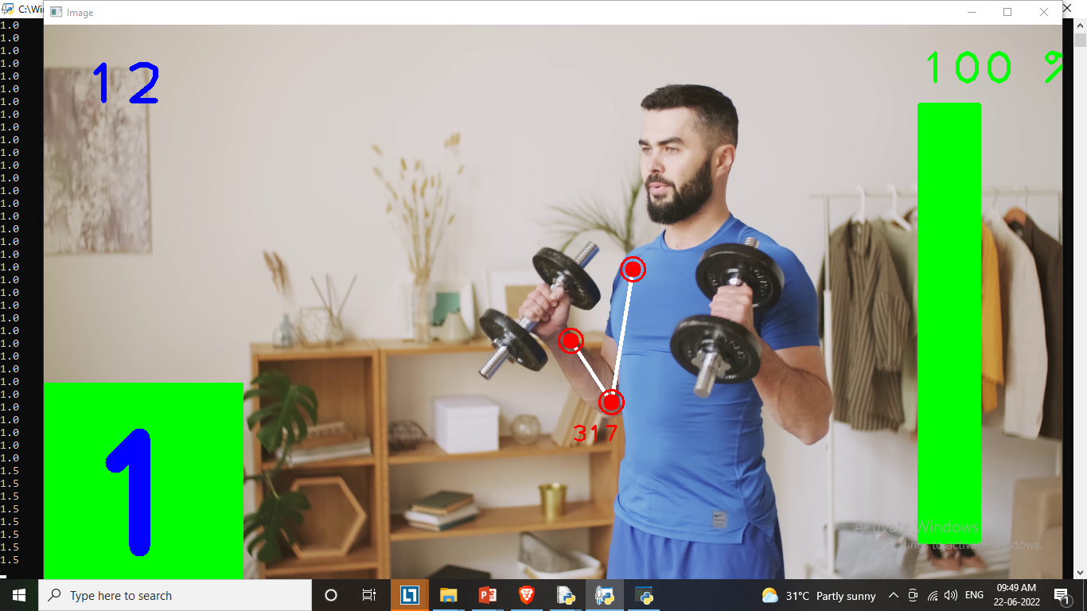
Screenshots

Slide 22
LIMITATIONS
The application can estimate the poses and count repetitions for a limited number of exercises as pose estimation using computer vision for some exercises and postures can be difficult.
The application is developed as a cross-GUI application and is not used as a mobile android/ios application.
The application cannot capture multiple people in the frame in the real-time system

Slide 23
CONCLUSION
AI is at the centre of a new enterprise to build computational models of intelligence.
This project based on AI Training using OpenCv and python have many future implementations like they can be used in this covid 19 .
Adopting and integrating AI technologies is a roller-coaster ride no matter how business-friendly it may sound.
A Deloitte report says, around 94% of the enterprises face potential Artificial Intelligence problems while implementing.

Slide 24
FUTURE WORK
There is a lot of scope of development in this project like it can be upgraded to support more exercises. The data collected by the AI Fitness Trainer can be saved and processed for the next sessions. The trainer will suggest you work out plan and its intensity according to your body type and weight.
The application can not only be used at homes but by increasing the scope can be used in gyms as smart trainers thus reducing the human intervention. Further application will also be able to provide personalized workout and diet plans. This application will offer different styles of yoga to give user an overall fitness regime

Slide 25
BIBLIOGRAPHY
Website
https://www.w3schools.com/python/
https://stackoverflow.com/
https://www.geeksforgeeks.org/python-tkinter-tutorial/
https://www.computervision.zone/
https://www.geeksforgeeks.org/opencv-python-tutorial/
https://www.w3schools.com/python/numpy/
https://www.youtube.com/c/NicholasRenotte
https://www.youtube.com/c/MurtazasWorkshopRoboticsandAI
https://www.youtube.com/c/Freecodecamp
https://www.youtube.com/c/edurekaIN
https://www.pexels.com
Tutorial
MediaFiles

Slide 26


